Slide 1
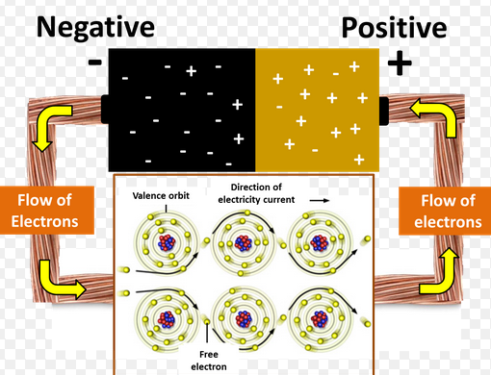
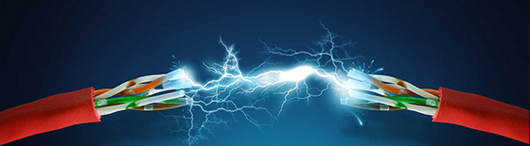
Electricity
Learning Objectives:
To understand the difference between voltage and current.
To identify the symbols for electrical components.
To begin drawing circuit diagrams scientifically.

Slide 2
The 9 types of energy
Starter: On your whiteboard write down the nine (9) forms of energy.
- S ________
- H ________ or T_________
- N________
- M________ or K _________
- L ________
- E________
- C_________
- G_________ P_________
- E_________ P_________

Slide 3
The 9 types of energy
In YOUR BOOK write the nine forms of energy.
- Sound
- Heat or Thermal
- Nuclear
- Movement or Kinetic
- Light
- Electrical
- Chemical
- Gravitational Potential
- Elastic Potential

Slide 4
Think:
Discuss on your table all the ways you have used electricity today. (2 mins)
Make a list of these on one mini-whiteboard.
I have used electricity today when:
  1.
  2. ……. etc
From the list indicate those that could be done without electricity, and give the alternative. (2 mins)

Slide 5
What is Electricity?
The clue is in the name!
Electricity is the flow of electrons around a circuit (connected conductors).
This flow of electrons is called the electrical current (I) and is measured in amps (A) using an ammeter.
The electrons are pushed around the circuit by the voltage (V) supplied by the cell/battery. Voltage is measured in volts (V) using a voltmeter.

Slide 6
Key Terms Summary – Write this in your book
Quantity | Symbol | Unit | Unit Symbol | Measured Using
Current | I | Amperes (Amps) | A | Ammeter
Voltage | V | Volts | V | Voltmeter
Resistance | R | Ohms | Ω | Ohmmeter

Slide 7
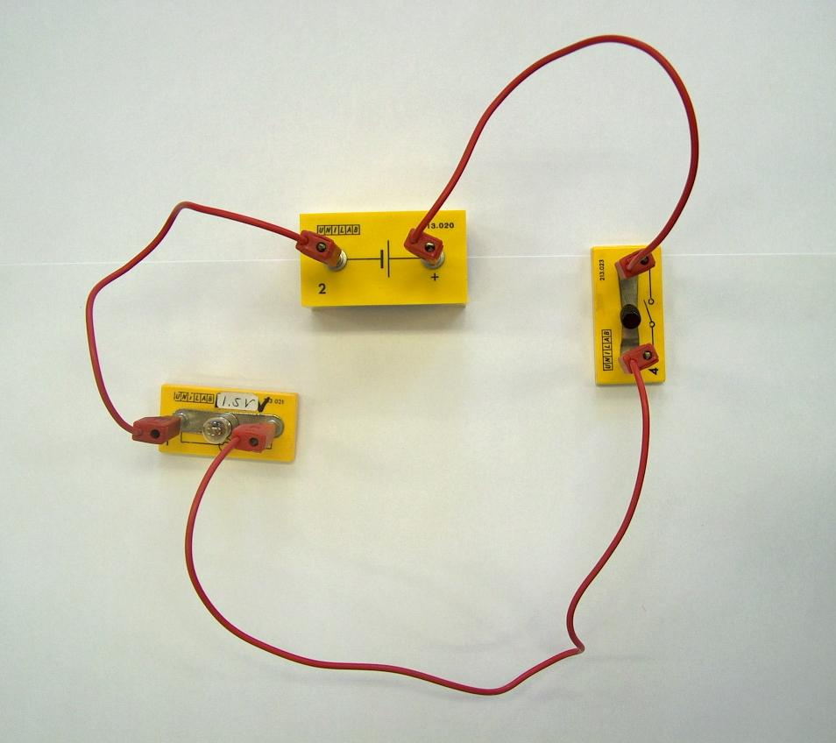
Electrical Energy
Consider a simple circuit:
The job of the battery is to convert ______ energy into _________ energy…
The job of the bulb is to convert the _________ energy it receives from the battery into ______ energy.
Words – electrical (x2), light, chemical

Slide 8

Electrical Energy
Hi. I’m Ernie Electron and I’m going to show you how I get energy around a circuit.
Energy

Slide 9
Electrical Energy
I leave from the negative terminal of the battery cell and I am attracted to the positive end.
Energy

Slide 10
Electrical Energy
Notice, the switch is ‘ON’ which means the circuit is closed and I am free to travel
Energy

Slide 11
Materials
Materials that allow electricity to pass through them are called CONDUCTORS.
  Give 3 examples
Materials that electricity does not pass through are called INSULATORS.
  Give 3 examples

Slide 12
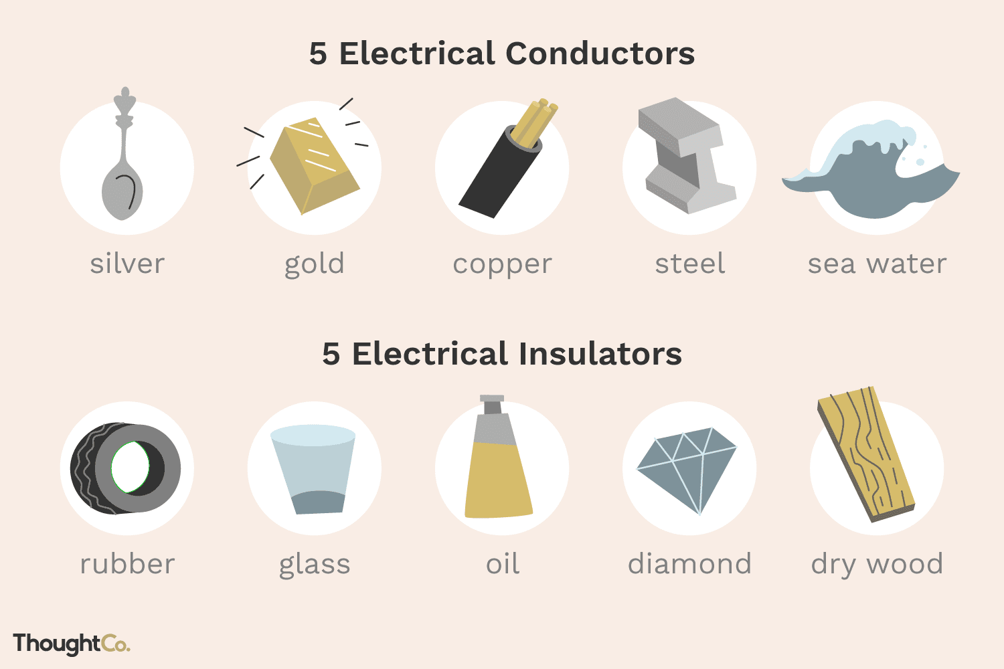

Slide 13
Why do metals Conduct Heat?
When you heat a metal strip at one end, the heat travels to the other end.
As you heat the metal, the particles vibrate, these vibrations make the adjacent particles vibrate, and so on and so on, the vibrations are passed along the metal and so is the heat. We call this?
Conduction

Slide 14
Why do metals conduct heat and electricity?
lectrons
The outer e_______ for metal atoms drift, and are free to move.
When the metal is heated or an electric current is passed though it, this ‘Sea of electrons’ gain k_____ energy and transfer throughout the metal, taking heat or electricity with them.
inetic
ood
lastic
Insulators, such as w___ and p____, do not have this ‘Sea of electrons’ which is why they do not conduct heat or electricity like metals.

Slide 15
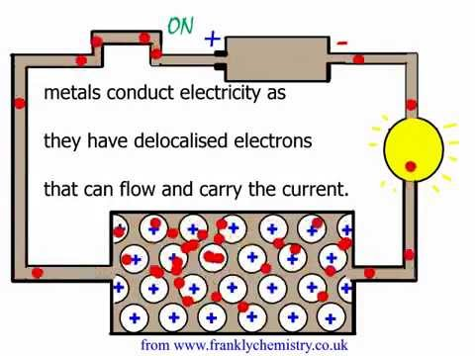
Why do metals conduct electricity?
Because electrons are negatively charged, they are attracted towards the positive terminal of the cell or battery when the power is on.
Resistance is a measure of how much a material tries to stop electricity passing through it.

Slide 16
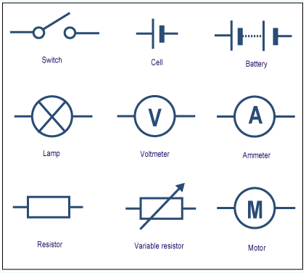
Circuit Symbols

Slide 17

Series circuit
Series circuits are ones where components are connected in one continuous loop or ‘circle’.

Slide 18
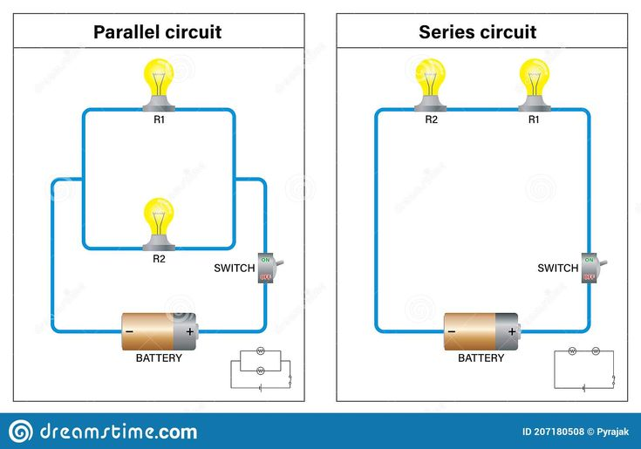
Parallel circuits
Parallel circuits have two or more separate loops coming of the same power source.

Slide 19
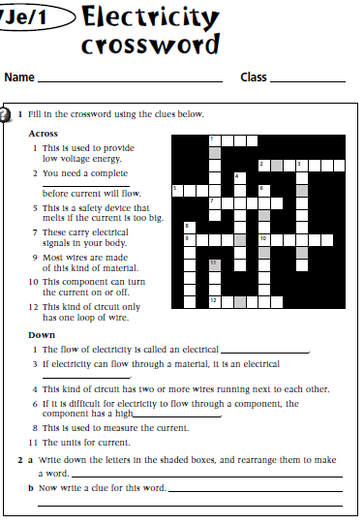
Your Turn!
Complete the crossword, using information covered today and your general knowledge.
Clues for tricky ones:
5 Across: When you have too many electrical devices on and the electricity goes off, mum or dad say “we blew a ______”.
7 Across: If you are annoying someone, they might say “You’re getting on my _______!”

Slide 20
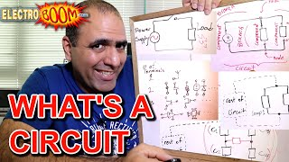

Slide 21
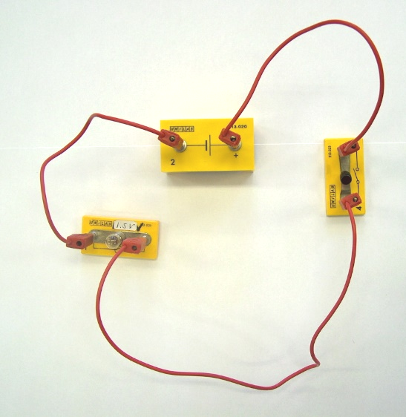
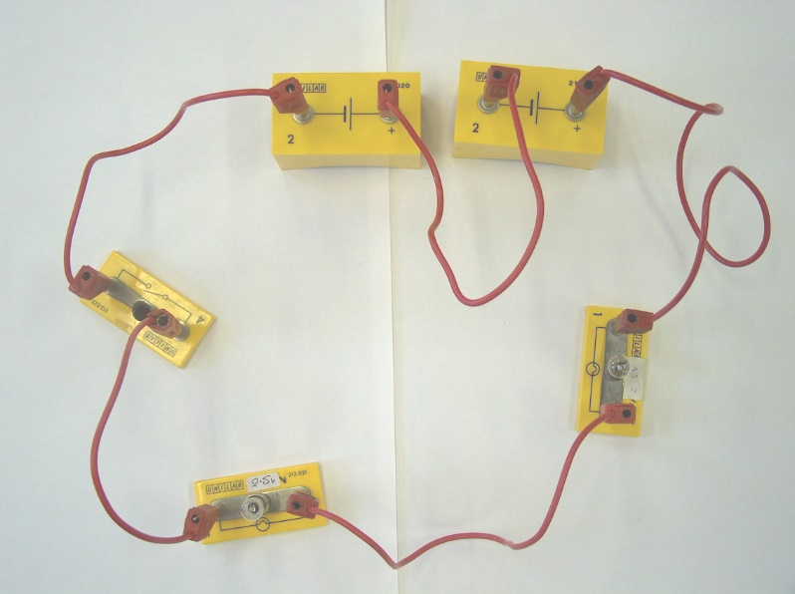
Drawing Circuits
1) A cell, a bulb and a switch “in series”
2) A battery of cells, a switch and two bulbs in series

Slide 22
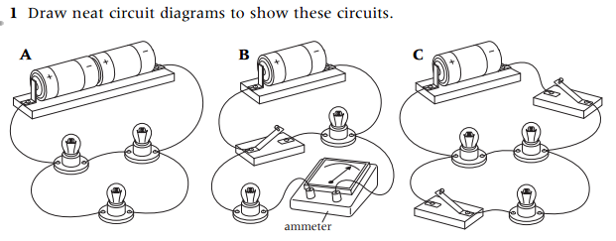
Using the symbols and processes learnt redraw these diagrams.

Slide 23
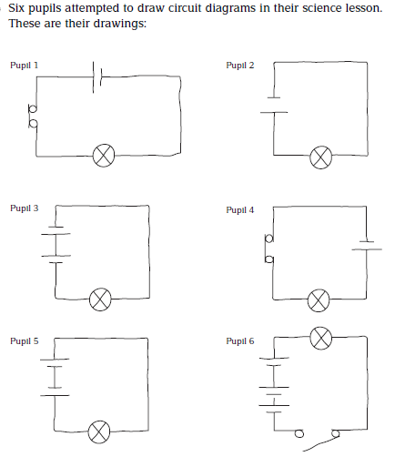
Six pupils attempted to draw circuit diagrams in their science lesson. Their drawings are opposite.
In which circuits will the bulb light up?
For those circuits where the bulb will not light, redraw the circuit diagrams so that they will.
In which of the circuits that you have drawn for Qu2 will the bulb be brightest? Explain your reasoning.
Where in a circuit does the switch need to be in order to operate the bulb correctly?

